Slide 1
Lesson 10 Final Presentation
By Alexander Olvera

Slide 2
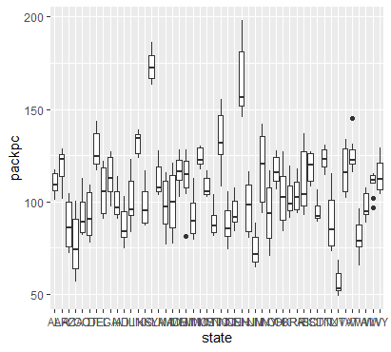
Create a boxplot of the average number of packs per capita by state. Which states have the highest number of packs? Which have the lowest?
New Hampshire has the highest number of packs per capita while Utah has the lowest packs per captia.

Slide 3
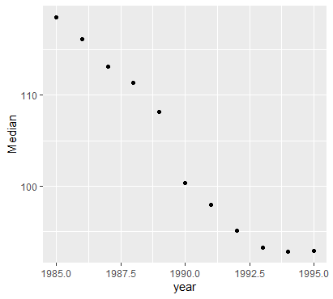
Find the median over all the states of the number of packs per capita for each year. Plot this median value for the years from 1985 to 1995. What can you say about cigarette usage in these years?
From 1985 to 1995, the usage of cigarettes across the united states has decreased .

Slide 4
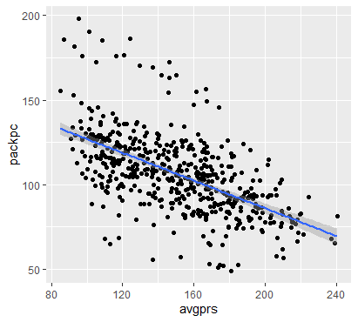
Create a scatter plot of price per pack vs number of packs per capita for all states and years. Are the price and the per capita packs positively correlated, negatively correlated, or uncorrelated? Explain why your answer would be expected.
The price and per capita packs are negatively correlated. This shows that as the price per pack is cheaper, the more people will buy them. The p-value is "2.2e-16", which is less than ".05". The correlation value is "0.5854443", which is a considerable amount.

Slide 5
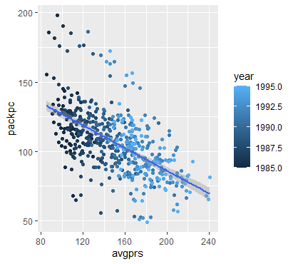
Change your scatter plot to show the points for each year in a different color. Does the relationship between the two variable change over time?
Overall, the variables follow the same negative trend from 1985 to 1995, with the exception of a few outliers.

Slide 6
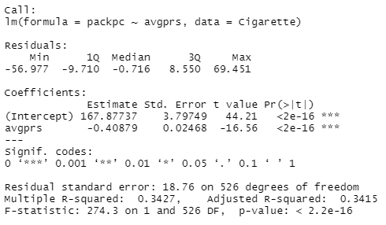
Do a linear regression for these two variables. How much variability does the line explain?
According to the Multiple R-squared value from the linear regression summary, this accounts for ~34% variability.

Slide 7
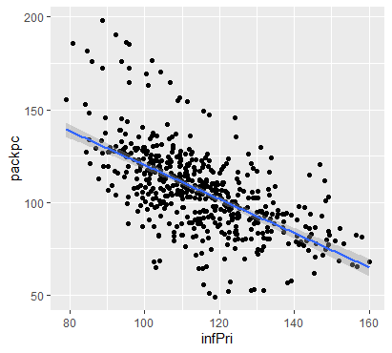
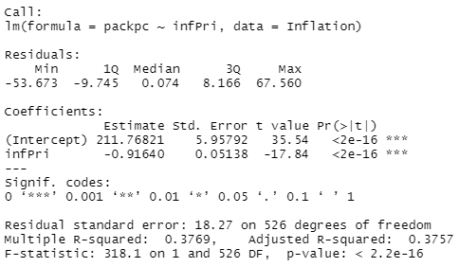
The plot above does not adjust for inflation. You can adjust the price of a pack of cigarettes for inflation by dividing the avgprs variable by the cpi variable. Create an adjusted price for each row, then re-do your scatter plot and linear regression using this adjusted price.

Slide 8
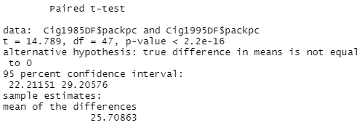
Create a data frame with just the rows from 1985. Create a second data frame with just the rows from 1995. Then, from each of these data frames, get a vector of the number of packs per capita. Use a paired t-test to see if the number of packs per capita in 1995 was significantly different than the number of packs per capita in 1985.
With a p-value of 2.2e-16 (being less than .05), there is a significant difference in the number of packs per capita in 1995 than in 1985.

Slide 9
Code used
install.packages("Ecdat")
library(Ecdat)
head(Cigarette)
View(Cigarette)
cigarette1 <- head(Cigarette)
library("ggplot2")
library("dplyr")
ggplot(Cigarette, aes(x=state, y=packpc)) + geom_boxplot()
MedianDF <- Cigarette %>% group_by(year) %>% summarise(Median = median(packpc))
ggplot(MedianDF, aes(x=year, y=Median)) + geom_point()
ggplot(Cigarette, aes(x=avgprs, y=packpc)) + geom_point() + geom_smooth(method=lm)
cor.test(Cigarette$avgprs, Cigarette$packpc, method="pearson", use="complete.obs")
ggplot(Cigarette, aes(x=avgprs, y=packpc, color=year)) + geom_point() + geom_smooth(method=lm)
RegressionDF <- lm(packpc~avgprs, Cigarette)
summary(RegressionDF)
Inflation <- Cigarette %>% mutate(infPri = avgprs / cpi)
ggplot(Inflation, aes(x=infPri, y=packpc)) + geom_point() + geom_smooth(method=lm)
RegressionDF2 <- lm(packpc~infPri, Inflation)
summary(RegressionDF2)
Cig1985DF <- Cigarette %>% filter(year == 1985)
Cig1995DF <- Cigarette %>% filter(year == 1995)
t.test(Cig1985DF$packpc, Cig1995DF$packpc, paired=TRUE)

